Slide 1
First of all, too many clicks!! → agreed on a more straightforward pathway to find the files?
Main one

Slide 2
Index

Slide 3
1. Soil maturation (Pedro)
*unsure of whether this should be included, but perhaps good to put in an organized manner to keep all pilot results together for supplementary information of Family paper

Slide 4
2. MeJA screening - Summary
We wanted to see phenotypic effects of MeJA in Brassicaceae plants, in order to make sure plants were indeed getting “stressed” for this we measured phenology and biomass. We were unsure of whether all plant species would react the same to the same concentration of MeJA (i.e. lowering biomass) and we wanted to know if high concentrations of MeJa (1mM) would be detrimental for more plant species than Brassica oleraceae and Arabidopsis as we observed white necrotic spots after dipping.
10 Brassicaceae species tested in 2 independent rounds; each round consisted of stratifying seeds for 72 hours and sowing in non-conditioned microp soil, germination % was measured and after 6 seedlings per species and treatment were transplanted to 1L non-conditioned microp soil. From this point onwards, phenology (as the number of true leaves according to the BBCH scale) was measured 3 times per week. Once plants reached the phenological stage of 3-5 true leaves the induction of stress with MeJA using the Berendsen et al (2018) dipping protocol started. Plants from the same round were then dipped at different times according to their phenology, we made 3 dipping times (fast-medium-slow). For this, we used different concentrations of MeJA, which were allocated randomly to different plant species. Following the protocol, 2 days after the last dipping plants were harvested. For some species leaf area (cm2) was measured. Shoots were dried at 72°C for 3 days and dry biomass was measured. Roots were sieved from the soil and stored in petri dishes with 20% ethanol at 4°C, the idea was to scan these roots to characterize root traits. Only a few species got scanned, for those dry biomass of the roots was measured.

Slide 5

MeJA screening – visual summary (1)
Germination efficiency
Time required to reach selected phenology
Measurement of plant traits
Made in “rounds” of plants, i.e. 6 species at a time + reference B. oleracea – Rivera (coated)
MeJA application
Transplant & growth
Harvest & processing
Sowing + germination
Seed stratification (4C)
(12)
(12)
(12)
(12)
(12)
(12)
(12)
50 seeds/species 6 species: 300 seeds
12pots/species 7 species: 84 pots
(6)
(6)
Soil conditioning
6. Phenological stages over time (BBCH scale, number of leaves)
8. Plant traits;
Non-destructive & Destructive: Shoot and root biomass, root shape
1. Germination efficiency (%)
2. Time for cotyledon emergence
3. Seedling height before transplantation
4. Timing before transplantation 5. Transplantation success (%)
Dipping in 0.015% Silwet 2x/week for 2 weeks
7. Plant traits;
Non-destructive: height, longest leaf
8. Phenotypic response to MeJA
Week 44-45
Week 46
Week 47
Week 48-51
Week 50-51
7 days
2 days
7-? days
14-21(?) days
2 weeks
48hrs
Per round → around 7 weeks
Tentative list of 34 species → 6 rounds
Round 1 + 2 sown this week: End by week 51-52
Notes:
Maybe we could have 9 pots/species and use the extra 3 to practise applying MeJA? And check for phenotypic effects?

Slide 6
MeJA screening – visual summary (2)
Round 1 + 2 = 9 species + 2x B. oleraceae
1st round of dips = 5 species
2nd round of dips = 4 species
MeJA application
3rd round of dips = 2 species
Camelina sativa
Berteroa incana
Arabis glabra
B. oleraceae wild
B. oleraceae Rivera
(12)
0.5mM
1mM
Round 1
Round 2
Brassica nigra
Sinapis arvensis
Barbarea vulgaris
Capsella bursa-pastoris
Brassica rapa
(6)
(6)
Dipping in 0.015% Silwet 4x/week for 2 weeks
Harvest also in 3 rounds = easier to handle, 1st starts tomorrow
Phenological stages of current plants: current planning Plant traits, what to measure?
Scanning with Justin

Slide 7
MeJA screening: summary results
Species | Lineage | Round | Dipping time | Family | MeJA concentration | Phenology | Final number of leaves | Shoot biomass | Root biomass | Leaf area | Root scan
Arabis glabra | Expanded lineage I | 1 | 1 - F | Yes-M | 0.5 mM | yes | yes | yes | yes | yes | yes
Brassica nigra | Lineage II | 1 | 1 - F | Yes-M | 1 mM | yes | yes | yes | yes | yes | yes
Brassica oleracea Kimmeridge | Lineage II | 1 | 3- S | Yes-S | 0.5 mM | Yes | Yes | Yes | no | No | No (?)
Brassica oleracea Riviera | Lineage II | 1 | 2 - M | Yes-F | 0.5 mM | Yes | Yes | Yes | Yes | No | Only controls
Sinapis arvensis | Lineage II | 1 | 2 - M | Yes - S | 1 mM | Yes | Yes | Yes | Yes | No | Only controls
Barbarea vulgaris | Lineage I | 2 | 1 - F | Yes-F | 1 mM | Yes | Yes | Yes | Yes | No | Only controls
Camelina sativa (Wild) | Lineage I | 2 | 1 - F | Yes – M (crop) | 0.5 mM | Yes | Yes | Yes | Yes | No | Only controls
Capsella bursa-pastoris | Lineage I | 2 | 1 - F | No | 1 mM | Yes | Yes | Yes | Yes | Yes | Only controls
Berteroa incana | Expanded lineage I | 2 | 2 - M | Yes-F | 0.5 mM | Yes | Yes | Yes | Yes | No | Only controls
Brassica rapa | Lineage II | 2 | 2 – M | Yes – M | 1 mM | Yes | Yes | Yes | Yes | No | Only controls
Brassica oleracea Riviera | Lineage II | 2 | 3 - S | Yes - ALL | 1st 0.5 mM and 2nd, 3rd and 4th with 1 mM | Yes | Yes | Yes | No | No | No (?)
Raw Data: rounds 1 and 2 Phenology_raw
& Biomass_raw tabs
Root Scans

Slide 8
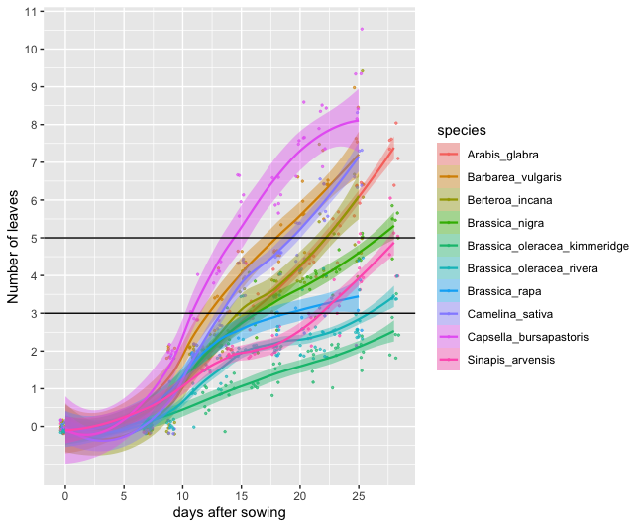
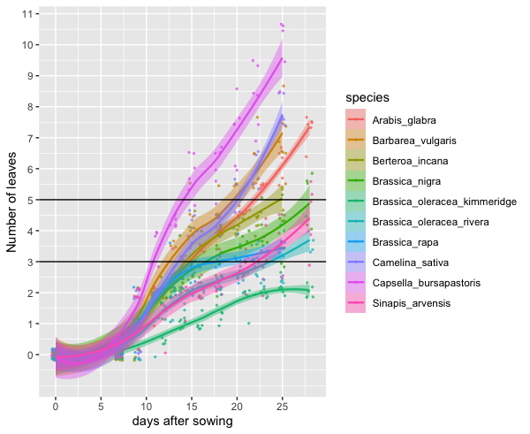
MeJA screening– Phenology (1)
10 Brassicaceae species tested
Same dipping protocol
6 reps/species
Control
MeJA
Raw Data: rounds 1 and 2 “Phenology_raw” tab
How is it best to organize R scripts?

Slide 9
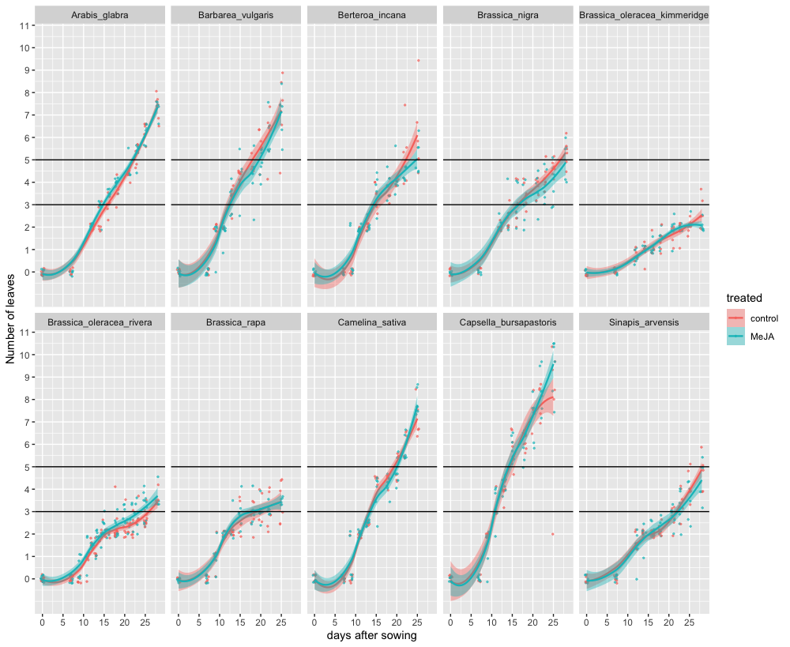
MeJA screening– Phenology (2)
Plot: Same as last slide but
separated by species
Raw Data: rounds 1 and 2 Phenology_raw tab

Slide 10
MeJA screening– Biomass
Plots from Pedro (couldn’t find them) + scripts
Raw Data: rounds 1 and 2 Biomass_raw tab

Slide 11
3. MeJA concentration pilot – Summary (1)
We wanted to find the right concentration of MeJA that causes stress and in return induce changes in the root microbiome. For this we measured both JA-dependent gene expression and sequenced root microbiome (endosphere and rhizoplane). We chose our 2 model species Arabidopsis thaliana and Brassica oleracea Riviera as representatives for lineage I and lineage II, respectively. A brief literature review was done to check MeJA concentrations and taking this, and the Berendsen et al (2018) paper as reference, it was decided to test 0.1mM and 1mM. The lower concentration was used in the Berendsen paper and 1mM was the uppermost limit if we still wanted to mimic an ecologically-relevant situation of insect herbivory (Marcel Dicke and Rita Gols, personal communication + still found in other papers). Negative controls consisted of dipping plants in 0.015% Silwet only, and positive controls consisted of 10 ul of Pieris brassicae caterpillar (L4-L5 instar) oral secretion (OS) applied on freshly-wounded plants using a pattern wheel (methodology recommended by Eric Poelman + literature review in next slide). Plants treated with caterpillar OS were dipped in the Silwet only solution first and left to dry before the wounding + OS application took place. For each combination of plant species (2) and treatment (4), six replicates were used consisting of an individual plant in a 1L pot.
**Brassica oleracea and Arabidopsis thaliana were sown at the same time, phenology at this point was not yet characterized for any of the species, therefore we waited until B. oleraceae had 3 true leaves to start the first dipping (21 days after sowing), meaning with this that Arabidopsis was in an advanced true-leaf stage (7-8 true leaves)**
Original research outline
MeJA_Research outline

Slide 12
Literature review for caterpillar OS
Reference | Mechanical damage | pureOS/plant(ul) | OSx1time(ul) | OSx4times(ul)
Poelman,2011.PNAS | Needle | 3 | 180 | 720
Poelman,2012.PlosBiology | Pattern wheel | 25 | 1500 | 6000
Halitschke,2000.Oecologia | Pattern wheel | 10 | 600 | 2400
Gouinguené,2001.Chemoecology | Scratching with razorblade | 10 | 600 | 2400
Petzold,2009.EcologicalEntomology | Syringe | 4 | 240 | 960
Menzel,2014.JofChemicalEcology | Pattern wheel | 10 | 600 | 2400
Chuang,2014.MolecularPlant-MicrobeInteractions | Puncture tool/paper punch | 100 | 6000 | 24000
deLange,2020.JofChemicalEcology | Puncture tool | 10 | 600 | 2400
Lortzing,2017.MolecularEcologyResources | Pattern wheel | 20 | 1200 | 4800
Sobhy,2017.JofChemicalEcology | Pattern wheel | 5 | 300 | 1200
Consales,2011.JofExperimentalBotany | Puncture tool/cork borer | 20 | 1200 | 4800
Schafer,2011.PlantPhysiology | Pattern wheel | 4 | 240 | 960

Slide 13
3. MeJA concentration pilot – Summary (2)
The first dipping was done 21 days after sowing and continued every 4 days for 4 times, following Berendsen et al (2018) methodology. Between 3 and 6 hours (?) after the last (4th) dipping, leaf material was collected and immediately frozen in liquid nitrogen for qPCR analysis. For B. oleracea plants 4 leaf discs were taken and 2 full leaves for A. thaliana (not possible to get full leaf-discs from small Arabidopsis leaves). All plants were harvested 2 days after the last dipping (35 das). For this, aboveground tissue was removed, and different traits were measured according to the species (see slide measured traits), roots were dry-harvested following XX protocol (nature paper?).
-rhizoplane and endosphere sampling
-dna extraction
-sequencing
-data analysis
Original research outline
MeJA_Research outline

Slide 14
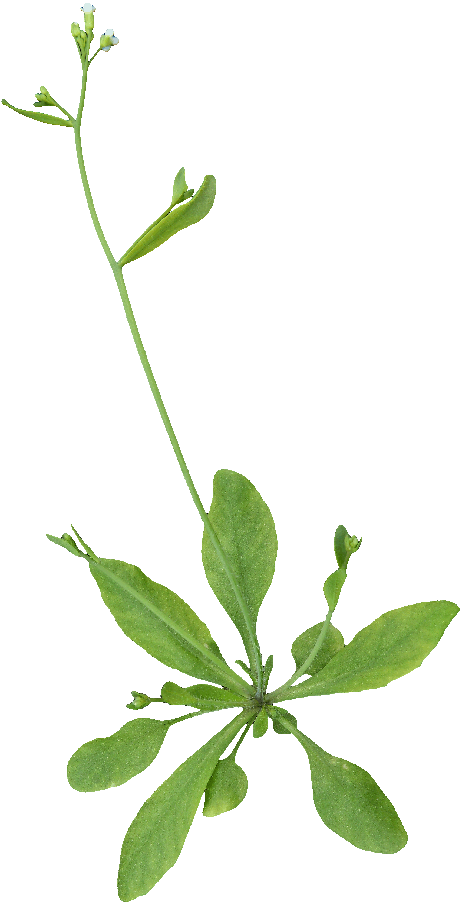
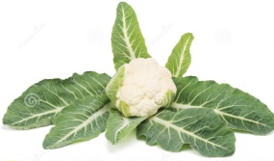
MeJA concentration - Visual Summary
Effect of soil conditioning on seed germination
Effect of MeJA concentration on JA-response genes
Arabidopsis thaliana
Brassica oleracea Riviera cvar
Sowing + germination
Transplant & growth
MeJA application
Sampling & gene expression
Seed stratification (4C)
(44)
(44)
Pre-conditioned tray (2 weeks)
(24)
(24)
(24)
(24)
4. Timing before transplantation 5. Transplantation success (%)
Leaf disc sampling 72 hours after last exposure (MeJA/caterpillar)
(44)
(44)
7. Plant traits;
Non-destructive Destructive: Shoot and root biomass
Non-conditioned tray (0 weeks)
(6)
(6)
(6)
(6)
Control (mock)
0.1mM MeJA
1mM MeJA (?)
Pieris brassicae
8. Expression of JA signaling genes (q-PCR); LOX2, MYC2
1. Germination efficiency (%)
2. Time for cotyledon emergence
3. Seedling height before transplantation
(24)
(24)
6. Phenological stages over time (BBCH scale, number of leaves)
Dipping in 0.015% Silwet every 2 days, 4 times total
5-10 caterpillars? and halved after X days
7. Plant traits;
Non-destructive: height, longest leaf
7. Plant traits;
Non-destructive: height, longest leaf
Week 43
Week 43-44
Week 44-46
Week 46-47
Week 48-49
2 days
7 days
9 days
8 days
3 days + 1 week

Slide 15
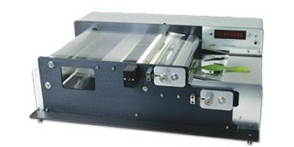
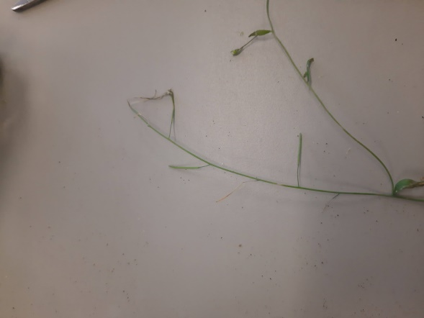

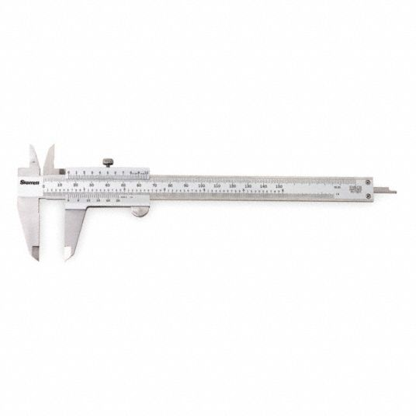
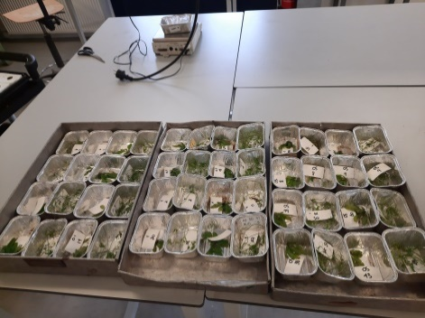
MeJA concentration – Measured traits
B. oleraceae
A. thaliana
1. Total leaf area (leaf area meter)
1. Total number of fruits
2. Leaf width (2nd leaf)
(24)
(24)
2. Leaf dry weight (72hrs at 60◦C) Not very accurate (qPCR sampling)
3. Leaf length (2nd leaf)
(6)
(6)
(6)
(6)
Control (mock)
0.1mM MeJA
1mM MeJA
Pieris brassicae OS
3. Leaf dry weight (72hrs at 60◦C)
3. Inflorescence dry weight (72hrs at 60◦C)

Slide 16
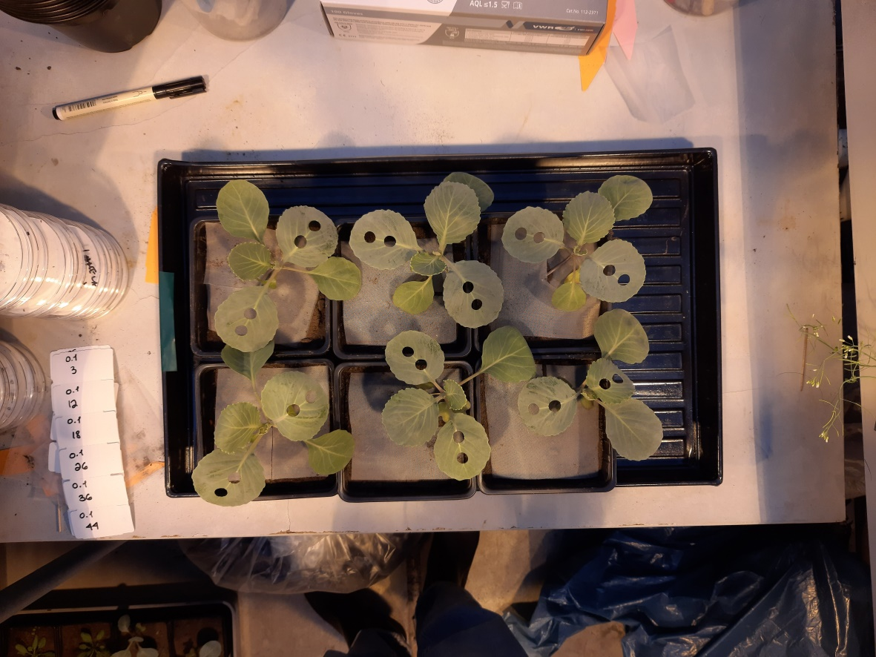
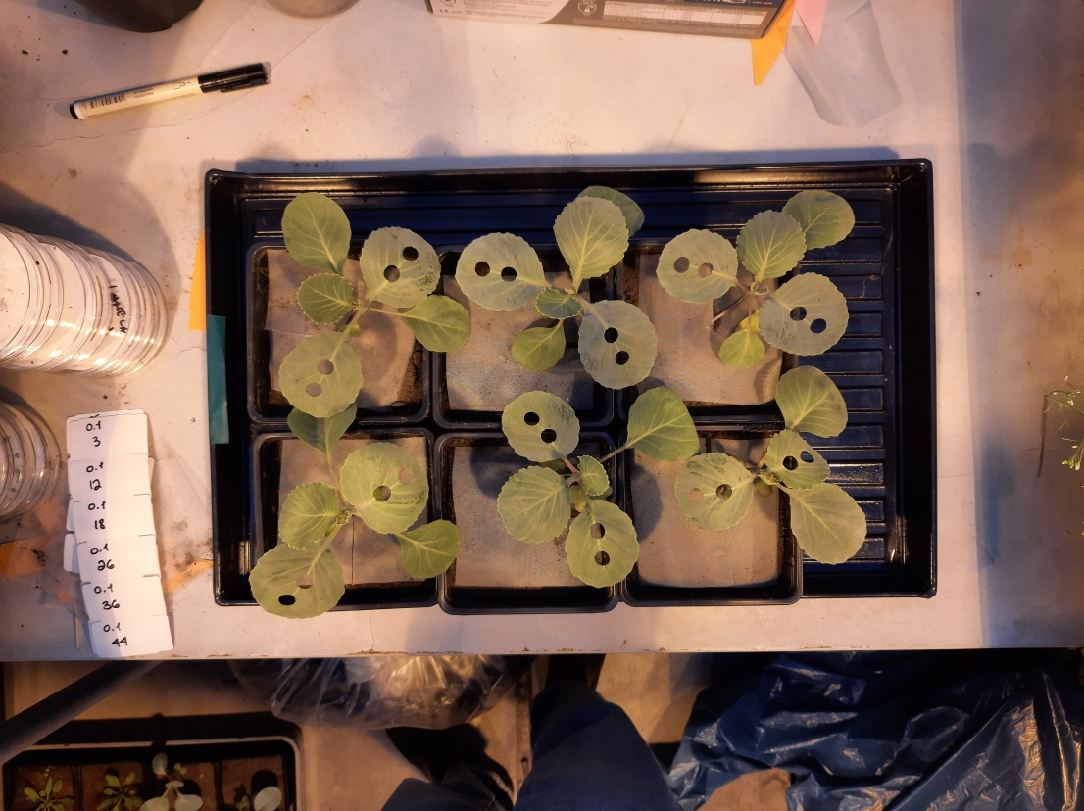
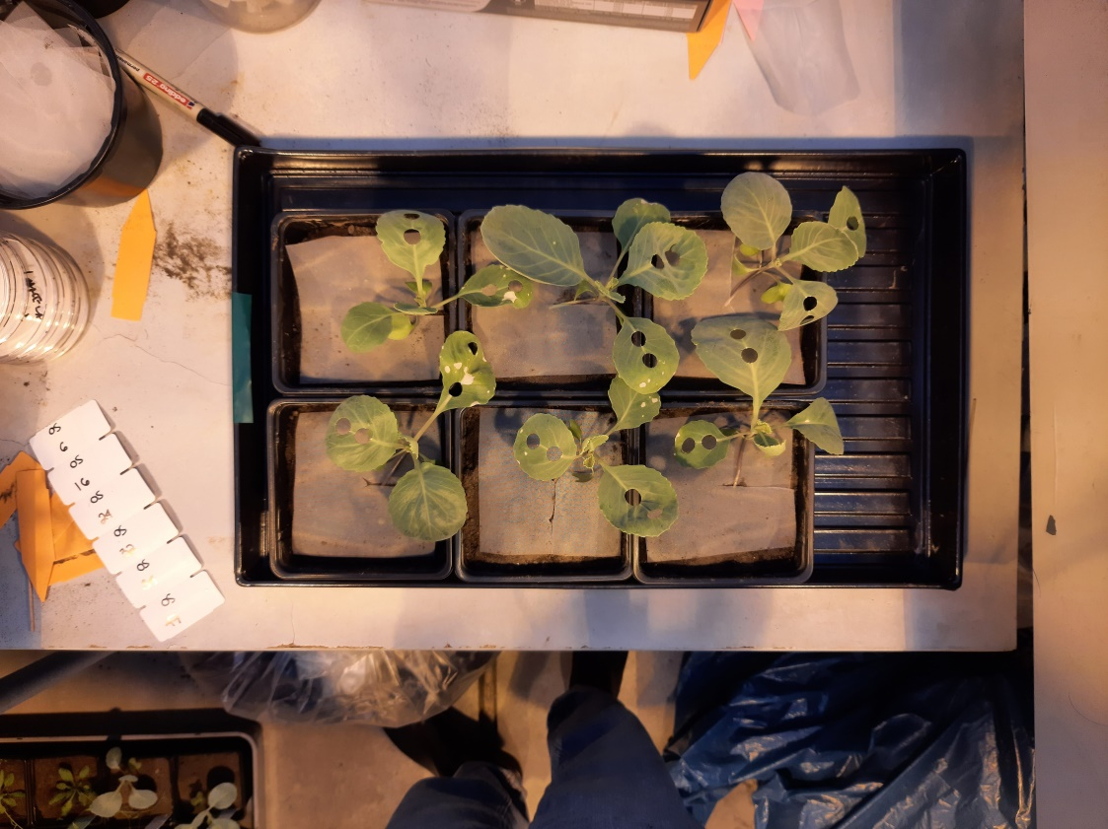
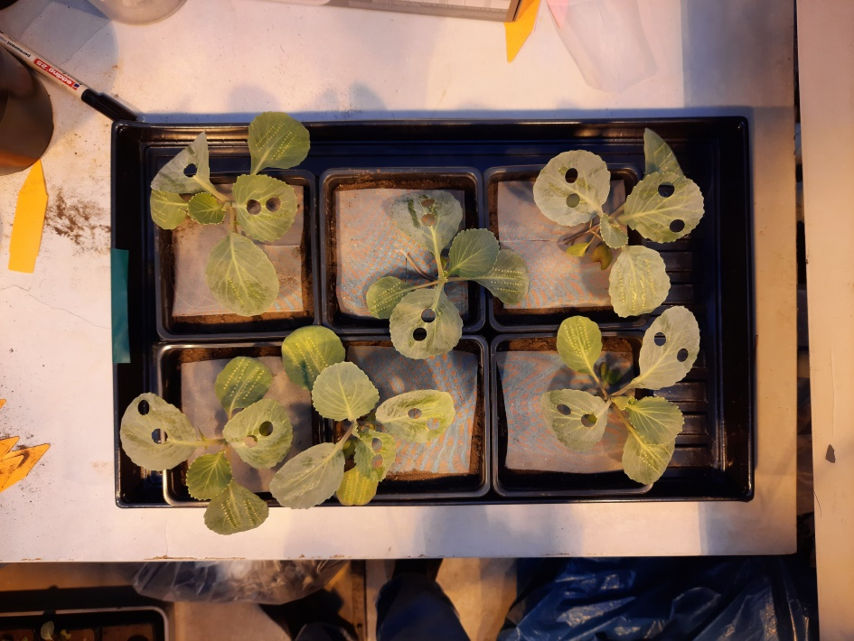
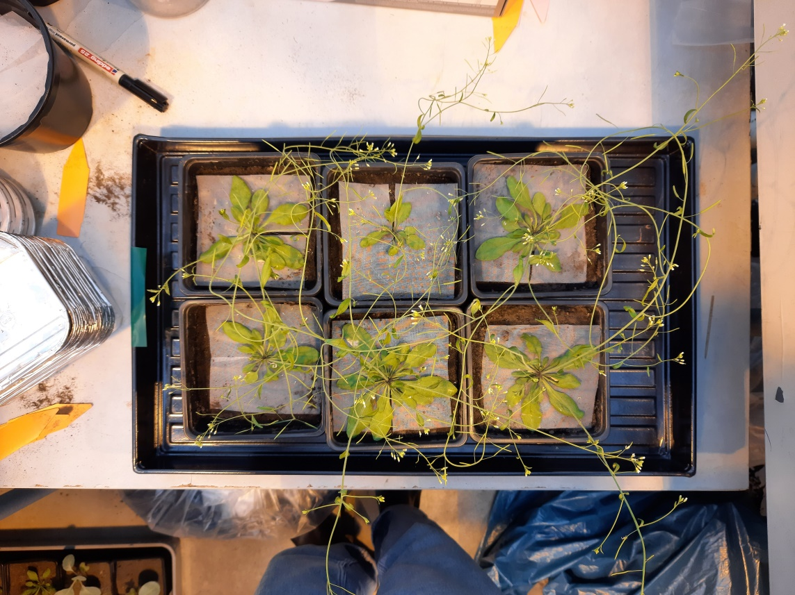
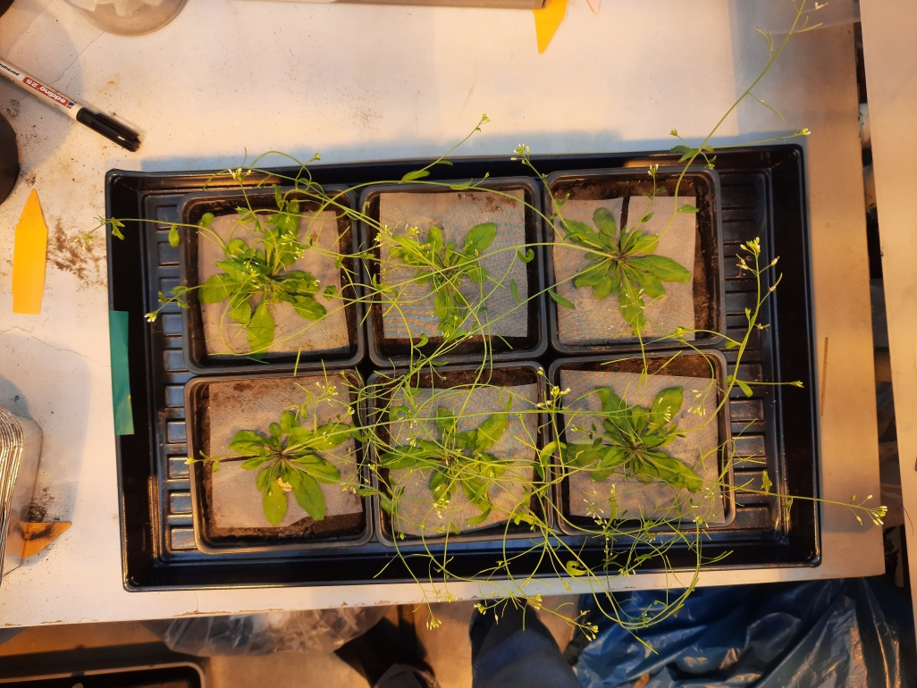
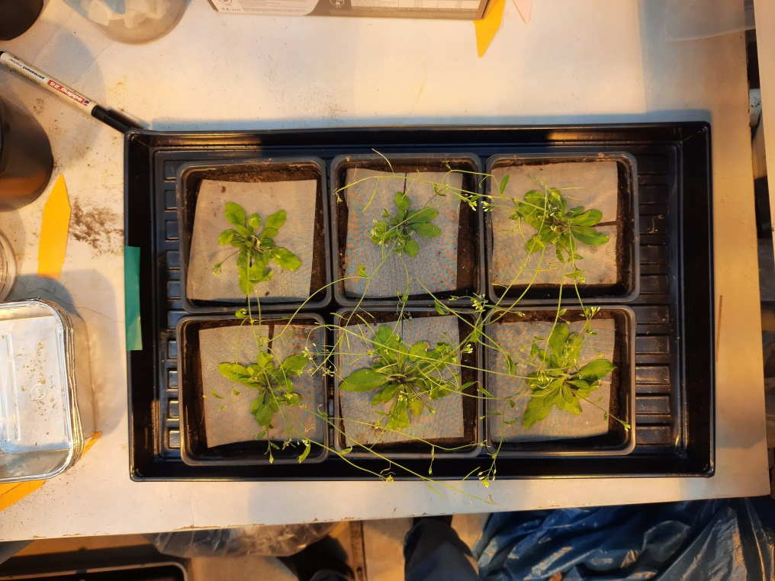
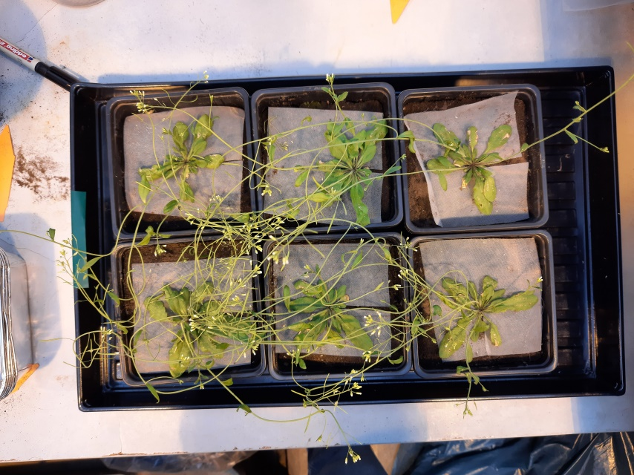
Mock control
0.1mM MeJA
1mM MeJA
P. brassicae OS
B. oleraceae
MeJA concentration – Pictures from harvesting day
A. thaliana
Pictures
35 days after sowing

Slide 17
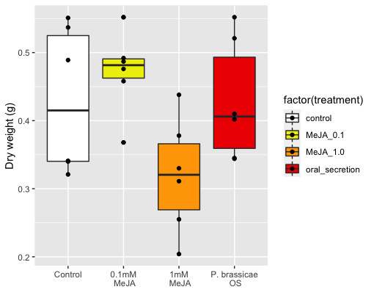
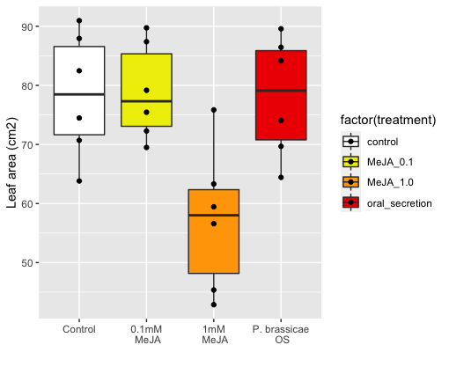
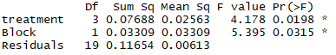
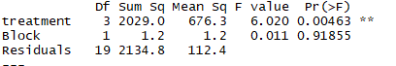
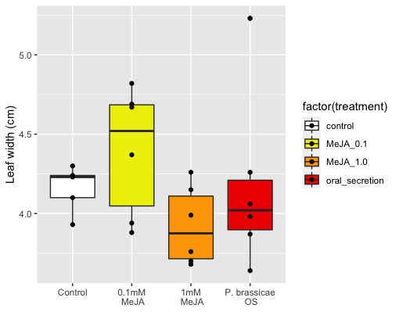
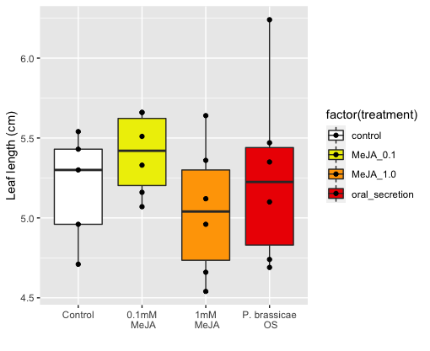
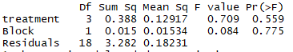
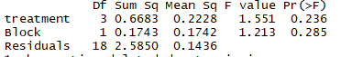
MeJA concentration – Results B. oleracea
ab
ab
a
a
a
a
b
b
Same trend for Dry weight and Leaf area LA -> good predictor
Less clear for LxW measurements
Clean data
For B. oleraceae:
1mM reduces significantly plant size for 0.1mM and P. brassicae OS were similar (also to controls!)

Slide 18
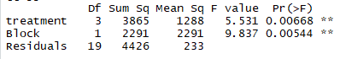
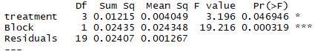
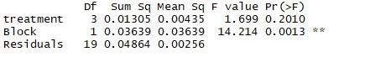
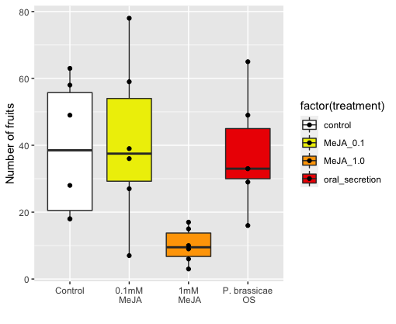
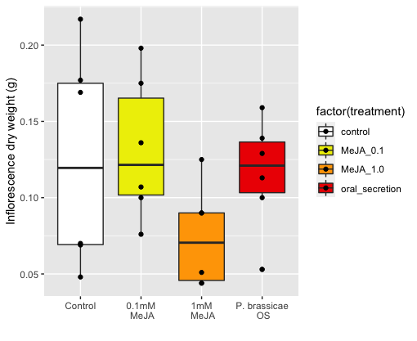
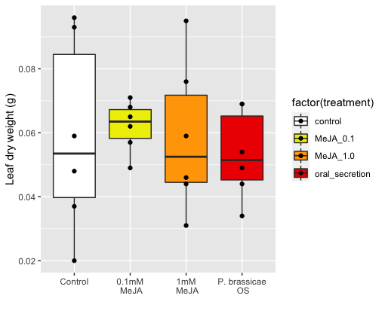
MeJA concentration – Results A. thaliana
a
ab
a
a
a
ab
b
b
Same trend for Number of fruits and Inflorescence DW
Not very accurate measurement
(uneven leaves removed for qPCR)
For A. thaliana:
1mM reduces significantly plant size 0.1mM and P. brassicae OS were similar
(also to controls!)
Clean data

Slide 19
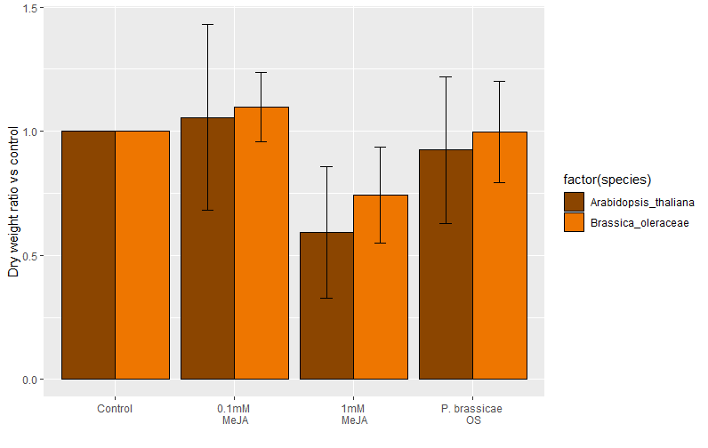
MeJA concentration – 2 species comparison
Inflorescence DW vs control
Leaf DW vs control
Mean + Stdev
Cohen's d
d estimate: -0.008485888 (negligible)
95 percent confidence interval:
lower upper
-1.294908 1.277936
Clean data
Cohen's d
d estimate: 0.4871191 (small)
95 percent confidence interval:
lower upper
-0.818236 1.792474
Cohen's d
d estimate: -1.148179 (large)
95 percent confidence interval:
lower upper
-2.5365490 0.2401916

Slide 20
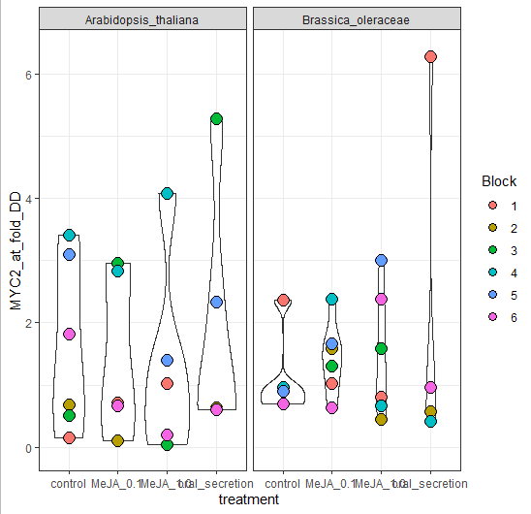
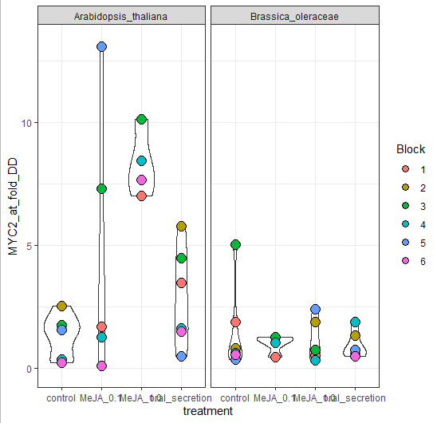
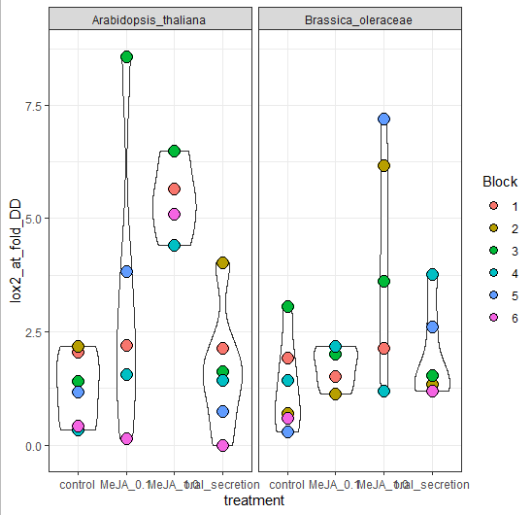
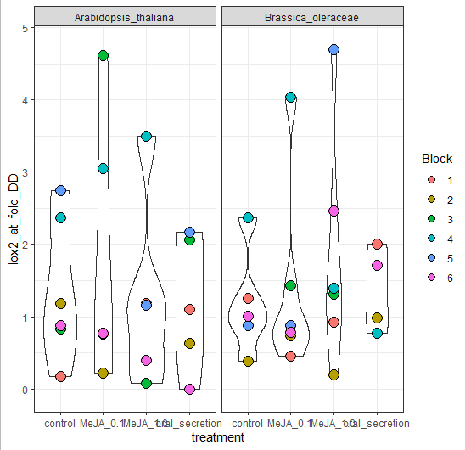
Reviewed qPCR labels and found a mismatch

Slide 21
From this slide on, only microbiome data plots

Slide 22
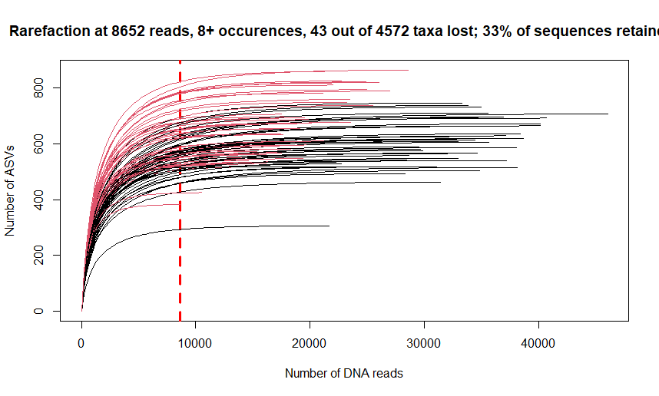
R script: 1_loading and pre-processing
Code Chunk :1.1 Decontamination process
2.509M sequences in BIOM table as input
A single OTU removed as part of decontamination
R script: 1_loading and pre-processing
Code chunk: 1.2 Chloroplast and mitochondrial DNA removal
2.509M sequences in BIOM table as input
2.421M sequences after plant host DNA removal
434+-11bp length
R script: 1_loading and pre-processing
Code chunk: 1.4a Rarefaction & rarefying
Drop from 2.341M to 0.796M sequences
No samples lost, plateau reached – very good sequencing dataset
R script: 1_loading and pre-processing
Code chunk: 1.3 Filtering out rare ASVs
Filtering at 8+ occurences
Drop from 7599 taxa to 4572 taxa
Drop from 2.421M to 2.341M sequences
Retains 99.48 % of sequences
Soil samples as red lines
Root samples as black lines

Slide 23
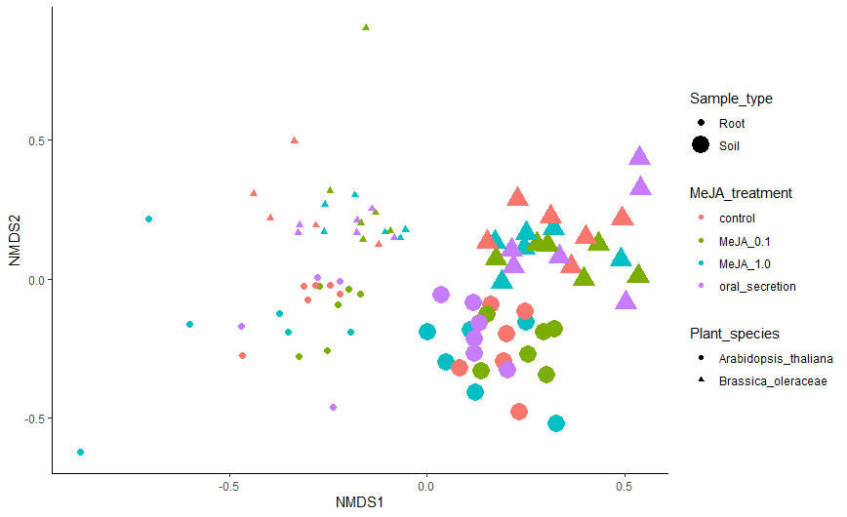
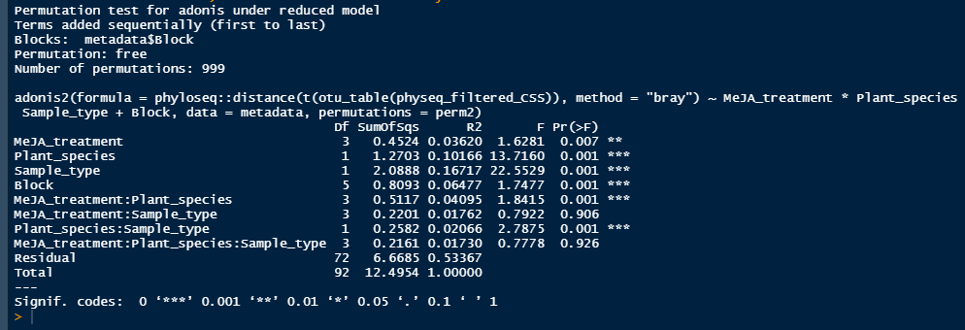
R script: 2_Beta_diversity
Code chunk: 2.1 - Beta Diversity plots
CCS normalization
Stress: 0.1521784 (ok)

Slide 24
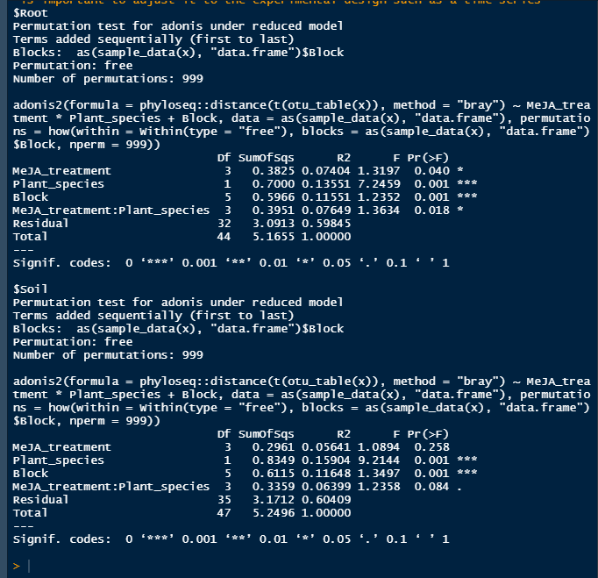
R script: 2_Beta_diversity
Code chunk: 2.3 - P values for beta diversity
The effect of root/soil depends on plant species
The effect of MeJA treatments depend on plant species
When we look at soils and root in separate (we know they are different anyway) we see….
….That the effect of MeJA treatment on root community depends on plant species
…. no effect of MeJA treatment on soil community, but interaction with plant species has p=0.08 at n=6/treatment

Slide 25
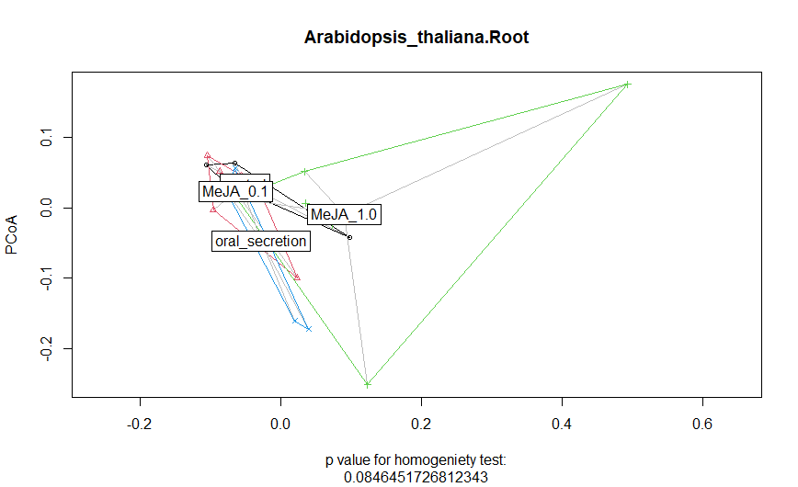
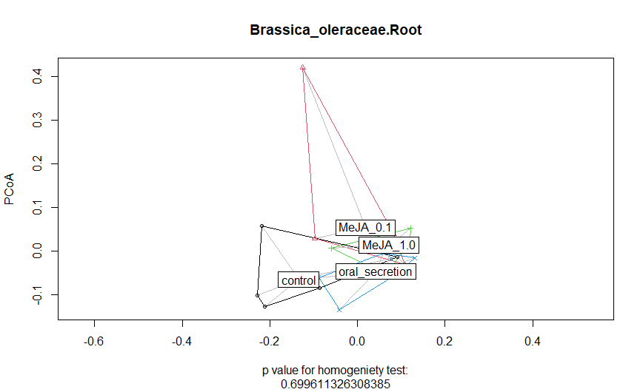
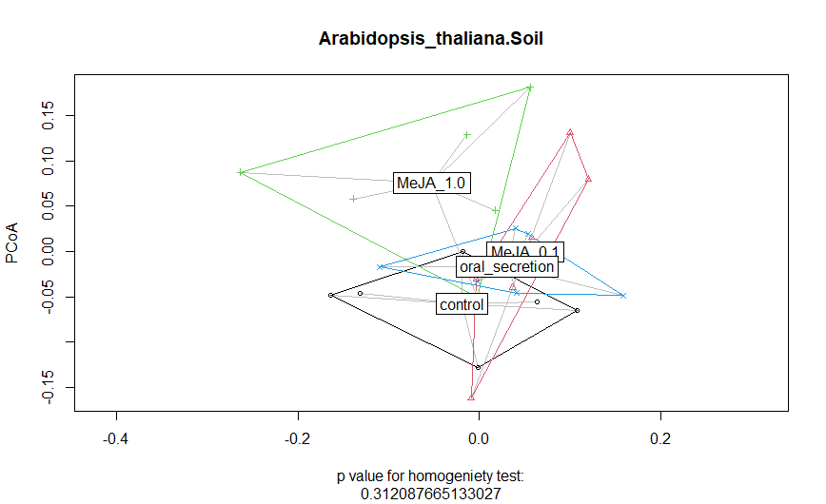
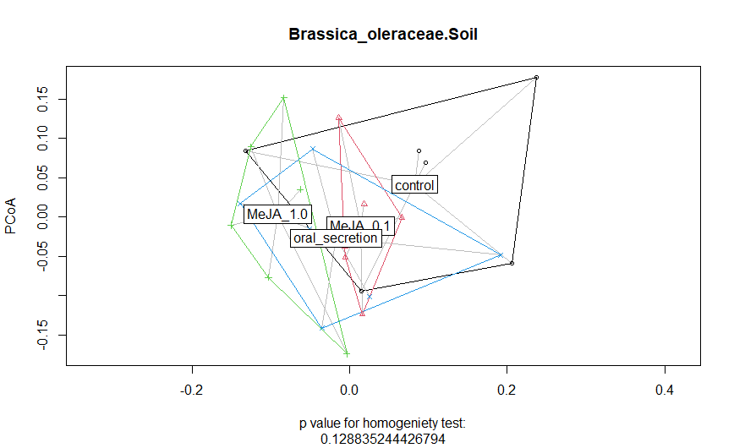
R script: 2_Beta_diversity
Code chunk: 2.2.1 - Beta Dipersion Metrics & plots

Slide 26
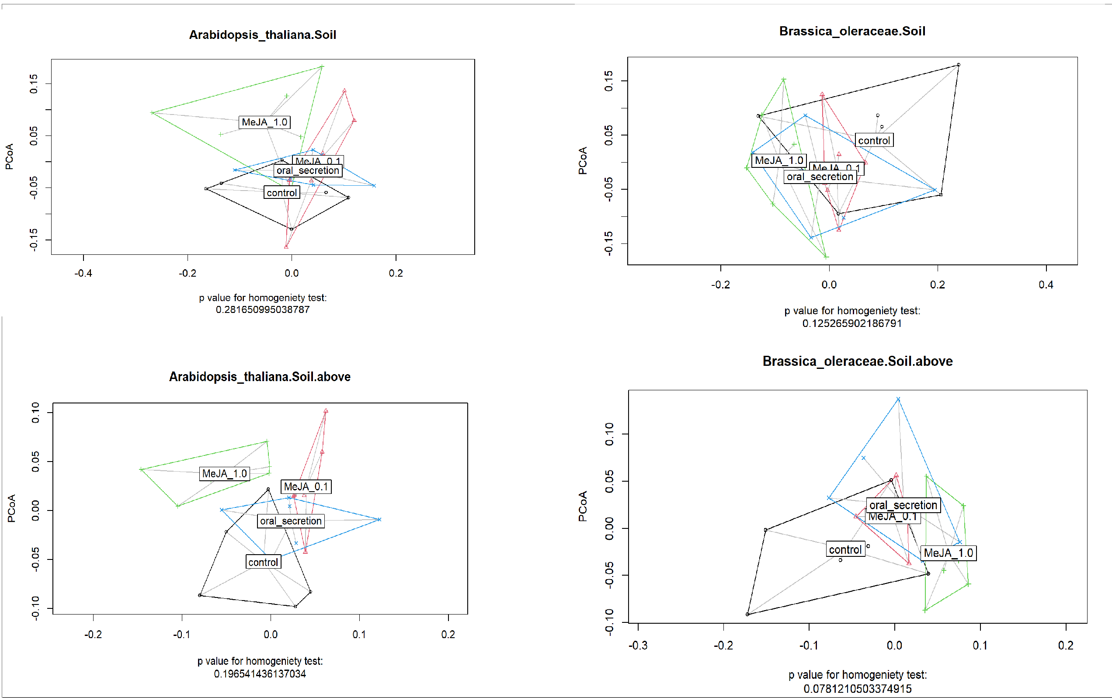

Slide 27
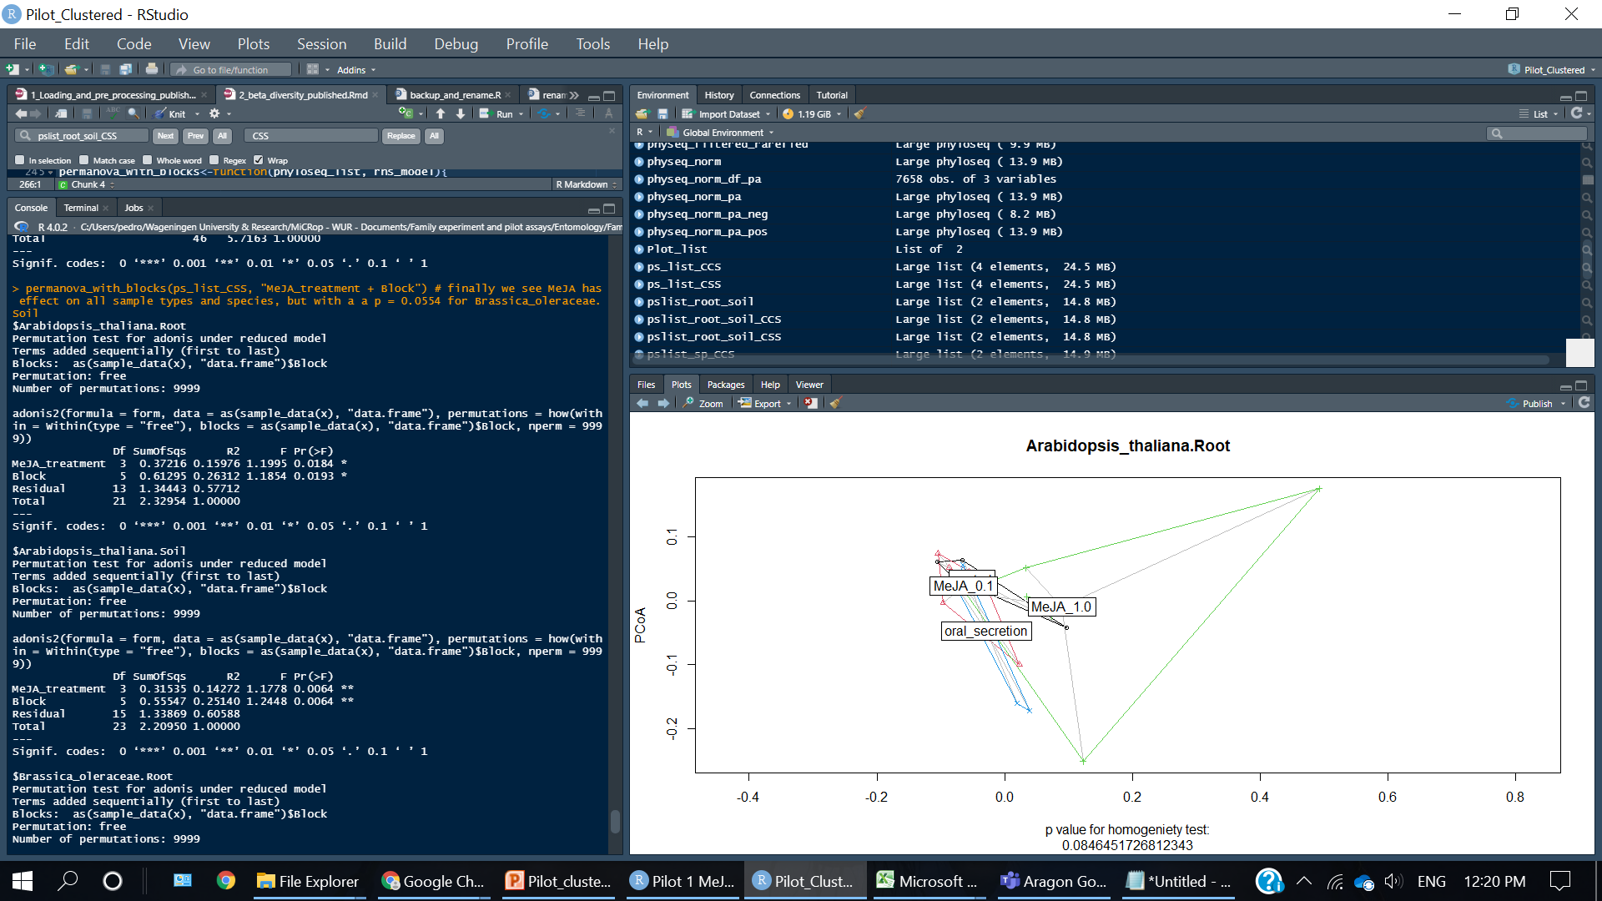
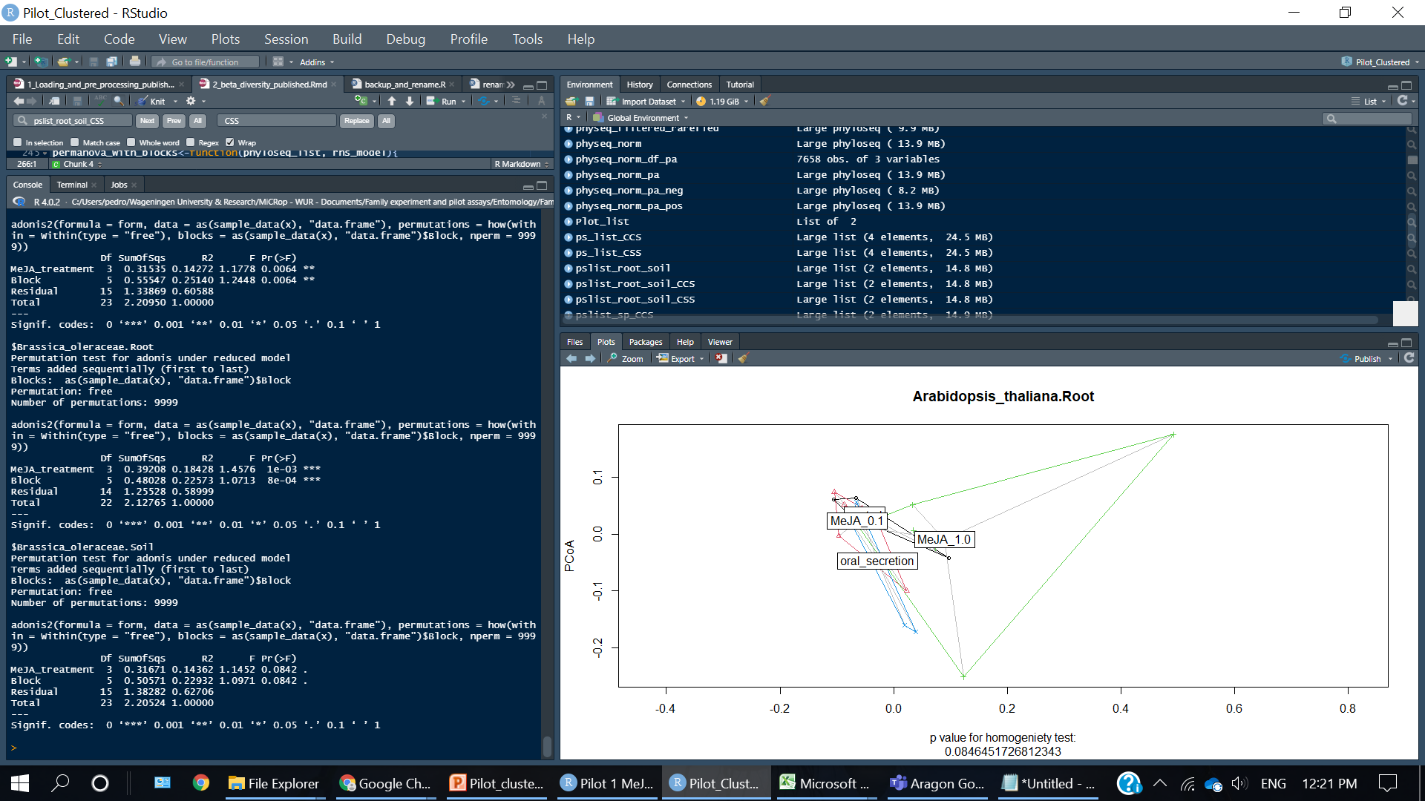
R script: 2_Beta_diversity
Code chunk: 2.3 - P values for beta diversity
Here we split the whole dataset in 4 for a detailed view
MeJA has an effect on AT Roots (p = 0.0184)
MeJA has an effect on AT Soil (p = 0.0064)
MeJA has an effect on BO Roots (p=0.0003)
MeJA has a marginally significant effect on BO Soil (p=0.0842)
Conclusion: Bacterial community in the soils of BO were less affected by MeJA than the other compartments and species

Slide 28
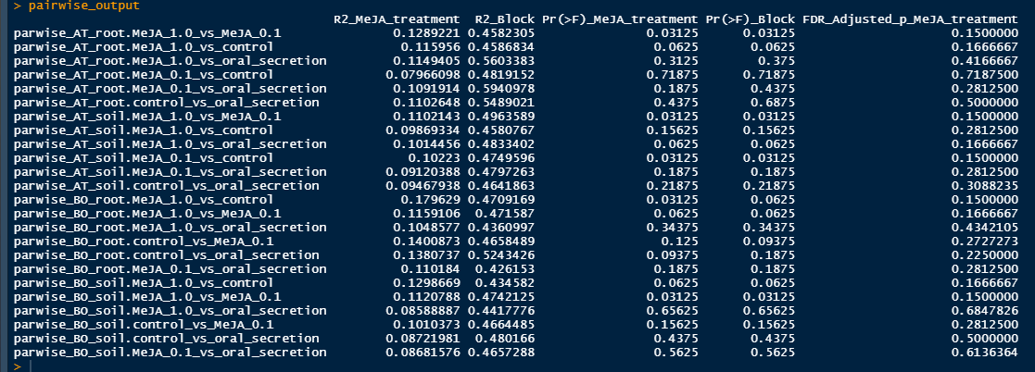
R script: 2_Beta_diversity
### 2.3.2a EcolUtils::adonis.pair - no lists, accounts for blocks. external FDR adjustment
No significant pairwise differences after FDR correction

Slide 29
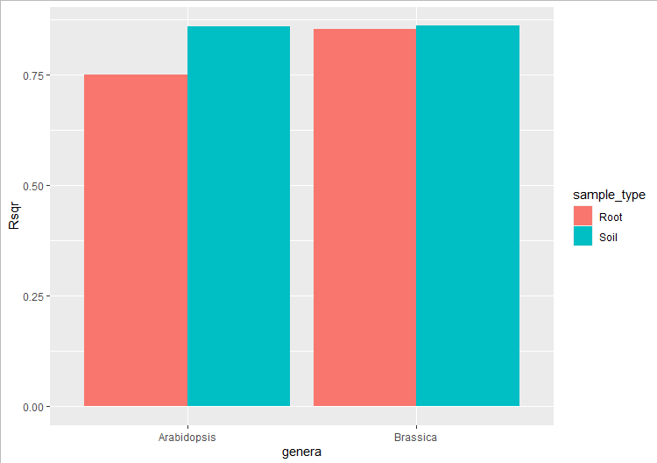
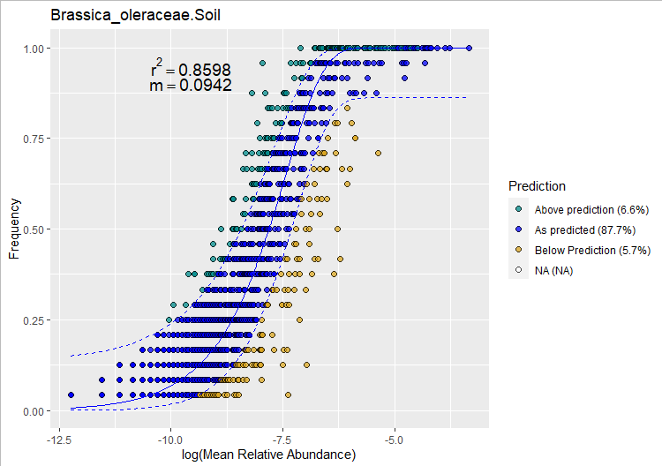




Migration occurence: if the individual is lost within the system, it is replaced from the outside
It is not too different from island biogeography
On the root/soil interface it does not mean migration from one pot to the other
It means recruitment/reproduction from with the community (that are already occurring in the niche/treatment) or from outside of it (rhizosphereci soil bulk soil, stem/leaf endohpytes
R script 4: Neutral models
Chunk: 4.2 calculate and plot neutral model distribution
Above: selected, enriched or recruited by plant
As predicted: present in many samples because it has a lot of sequences
Below prediction: dispersal limited, infests a few plants…
… (because it cannot move in the environment, failes to stablish new populations, or can only infest a portion of the plants….)
Roots of AT have a lower fit to the neutral model…. (they are under more intense/active selection
With a slightly higher number of OTUs above predictions

Slide 30













AT roots
AT Soil
BO roots
BO soil
Similar: treatment do not change positively selected bacteria (converging selection)
Different: treatment does change positively selected bacteria (treatment-based selection)
0.1014
0.006 **
0.0088**
0.1737
Similar: treatment do not change pervasive background community (base structure of community unaltered)
Different: treatment do changes pervasive background community (fundamental community changes , changes landscape of assembly)
0.0051 **
0.015 *
BO soil above – shared subset of selected mirobes
0.0647
0.055.
Similar: treatment do not change dispersal-limited community
Different: treatment do changes dispersal-limited community
(proliferate in suceseptable individuals)
0.2654
0.0054**
0.0546.
0.0359 *
No significant pairwise differences after fdr

Slide 31




R script 4: Neutral models
Chunk: 4.6 one model for each BO_soil treatment, using all BO_soil samples as a pool
n = 6 is quite low, we should be careful
Strongly affected by unequal samples sizes (some AT roots n=4)
Similar patterns in other for AT and for roots
Similar R² and m values across treatments – similar selection pressures and migration scale

Slide 32


All BO_soil OTUs
Only BO_soil OTUs classified as above expected in 4 neutral model (one for every treatment)
Stress = 0.1755
MeJA effect p = 0.0842
MeJA effect R2 = 0.14
Stress = 0.08506791
MeJA effect p = 0.001
MeJA effect R2 = 0.63
Script 4 Neutral models
Chunk 4.6 one model for each BO_soil treatment

Slide 33


Above prediciton
These are only OTUs classified as above expected when we run one individual model for each MeJA treatment
Stress 0.0398
no taxa lost at rarefaction, consistent result on CCS
Script 4 Neutral models
Chunk 4.6 one model for each BO_soil treatment

Slide 34


Above selected
Script 4 Neutral models
Chunk 4.6 one model for each BO_soil treatment

Slide 35




Script 4 Neutral models
Chunk 4.6 one model for each BO_soil treatment
As predicted
Stress = 0.2054
MeJA effect p = 0.001
MeJA effect R2 = 0.35
Below prediction
Stress = 0.2279
MeJA effect p = 0.001
MeJA effect R2 = 0.26

Slide 36

As_predicted
Script 4 Neutral models
Chunk 4.6 one model for each BO_soil treatment

Slide 37

Script 4 Neutral models
Chunk 4.6 one model for each BO_soil treatment
Below prediction

Slide 38




Script 4 Neutral models
Chunk 4.6 one model for each BO_soil treatment
All pairwise corrected p values between p=0.0035 and p = 0.0069

Slide 39










Script 4 Neutral models
Chunk 4.7 one model for each AT_soil treatment
AT_soil above
AT_soil predicted
AT_soil below
Stress = 0.1931
R² = 0.70
P = 0.001
Stress = 0.065
R² = 0.72
P = 0.001
Stress = 0.2023
R² = 0.48
P = 0.001
All pairwise between p= 0.0029 and 0.0069

Slide 40





Script 4 Neutral models
Chunk 4.7 one model for each AT_soil treatment

Slide 41

Script 4 Neutral models
Chunk 4.9 check for artefacts in the methodology
Here we select random OTUs from each treatment, instead of selecting the ones tagged as above expected
We select a number of OTUs identical to that of the list fo aove expected OTUs
We are looking at p and R2 values for MeJA effects of 100 random draws, for both AT and BO soils
Max
Mean
Min
Sd
median
Some p values of random draws can be <0.05 (40x for AT, 9x for BO)
Minimal p value can be similar to that of the tests (1e-4).. But only because the output does not get further details!
But explained variance is 6.48x higher for the neutrally selected than random (~0.90 VS ~0.14)
And F value is also much higher in the neutral selected (F = 73.44 for AT and 80.94 for BO) than random draw (F max 1.42 and 1.45)
That it, the much more clear clustering we observed with above selected OTUs could not have been possible by drawing random OTUs

Slide 42






Draw random OTUs from the sp_soil split (n=24) and run permanovas
Above-neutral OTUS:
BO MeJA F = 80.94
AT MeJA F = 73.44
Above-neutral OTUS:
BO MeJA R2 = 0.918
AT MeJA R2 = 0.906
Above-neutral OTUS:
BO MeJA p = 1e-4
AT MeJA p = 1e-4
Draw random OTUs from the treatment (n=6), then join in the sp_soil split (n=24) and run permanovas
Above-neutral OTUS:
BO MeJA R2 = 0.918
AT MeJA R2 = 0.906
Above-neutral OTUS:
BO MeJA p = 1e-4
AT MeJA p = 1e-4
Above-neutral OTUS:
BO MeJA F = 80.94
AT MeJA F = 73.44

Slide 43



Both AT and BO,
Only as expected
Both AT and BO,
Only above expected
Both AT and BO,
Below prediction
Script 4 Neutral models
Chunk 4.8 mixing AT and BO plos

Slide 44

As predicted
Above
Bellow
Script 4 Neutral models
Chunk 4.8 mixing AT and BO plos

Slide 45


Network roadblock solved
Misuse of edge weights when calculating inter-module connectivity
(sub-curated function found online…)

Slide 46


R script: 2_Beta_diversity
Code chunk: 2.2.1 - Beta Dipersion Metrics & plots ####

Slide 47





Slide 48


R script: 3_Alpha_diversity
Chunk: 3.1 Alpha diversity testing
Observed number of species
Shannon diversity index

Slide 49



R script: 3_Alpha_diversity
Chunk: 3.1 Alpha diversity testing, observed number of taxa
Shannon diversity index
All similar, group “a”
abcd
abcd
Clear interaction between plant species and sample type.
AT had more diversity than BO on soil samples
BO had more diversity than AT on root samples
MeJA treatment effect, mostly on BO roots
de
bcd
de
de
cde
e

Slide 50



R script: 3_Alpha_diversity
Chunk: 3.1 Alpha diversity testing, observed number of taxa
Observed number of species
Clear interaction between plant species and sample type.
AT had more diversity than BO, but only on soil samples

Slide 51


Split: $Root $Soil: no Meja effect, but plant effects are significant
R script: 3_Alpha_diversity
Code chunk: 3.1.2b testing lists - Shannon diversity
Shannon indexes: differ in MeJA for roots of BO; effect on other 3
Big block effects
Clear MeJA effect
In BO roots, Controls have less diversity than MeJA 0.1 and oral secretion
Other comparisons are non-significant

Slide 52






Networks differ from a random network
Good fit to power law
Soils more complex than root

Slide 53




Module_eingengene_correlations_to_plant_metadata: Correlations between modules eigengenes (the decomposition of the module’s members CSS-transformed frequencies into a single principal component) and plant phenotype (plant dry weight, MYC2 expression and LOX2 expression). Correlations with p >0,1 are omitted. Modules with less than 2 members and modules detached from the main network component are not shown.

Slide 54




AT_root
Class per module
Chunk6.7c
AT_root
BO_root
Figure_module_Class: log-transformed abudances of ASVs present in the 6 first network modules, binned at Class level
BO_soil

Slide 55




AT_root
Order per module
Chunk6.7c
AT_root
BO_root
Figure_module_Orders: log-transformed abudances of ASVs present in the 6 first network modules, binned at Orderlevel
BO_soil

Slide 56




AT_root
Family per module
Chunk6.7c
AT_root
BO_root
Figure_module_Family: log-transformed abudances of ASVs present in the 6 first network modules, binned at Family level
BO_soil

Slide 57




AT_root
genus per module
Chunk6.7c
AT_root
BO_root
Figure_module_Genus: log-transformed abudances of ASVs present in the 6 first network modules, binned at Genus level
BO_soil

Slide 58

figure_ASV_mod13: rarefied abundance of ASVs in module 13 of A. thaliana endophytic network, clustered per treatment

Slide 59








AT roots
AT Soil
BO roots
BO Soil
Connectors: link many modules
(sub-communities) together
Hubs: Strongly structure a specific module
Keystones: Relevant in overall network structure

Slide 60




Slide 61






100-repeated 5-fold cross validation of train/test datasets this is done for each of the 4 data splits (both full feature and boruta-selected models)
Full features
boruta-filtered features
Confusion matrix,
boruta-filtered features
Confusion matrix,
Full features
Sample Set |  | ASVs input | Accuracy |  | Kappa
AT_root (n = 22) | Full RF | 2690 | 0.3282 | 2.46 x | 0.1097 | 6.77 x
 | Boruta | 11 | 0.8086 |  | 0.7426
AT_soil (n = 24) | Full RF | 3124 | 0.3571 | 2.30 x | 0.1750 | 4.35 x
 | Boruta | 7 | 0.8204 |  | 0.7609
BO_root (n = 23) | Full RF | 2421 | 0.4898 | 1.82 x | 0.3350 | 2.55 x
 | Boruta | 16 | 0.8911 |  | 0.8533
BO_soil (n = 24) | Full RF | 2558 | 0.3533 | 1.92 x | 0.0908 | 7.39 x
 | Boruta | 6 | 0.6784 |  | 0.6714

Slide 62




Boruta on a single 94 sample run (500 trees/forest)
All-feature random forest
Boruta-selected features random forest
Accuracy ~2.5x higher as the random process is re-calculated

Slide 63
In AT_root
MeJA 1.0
MeJA 0.1
Oral
control

Slide 64

Heat trees show full taxonomy
A full phylogentic tree with colors and sizes representing taxa abundances
Also shows significant pairwise differences
Metacoder:: heat_tree_matrix ()
The trick is to focus on one section at a time…
BO_SOIL

Slide 65


MicEco:: ps_venn()
Comparing Controls with other treatments
g__67-14
Rhizobacter
g__Bosea
g__Sporocytophaga
g__A21b
g__pelomonas
Taxa consistently more abundant in treatments than controls
Taxa consistently more abundant in controls than treatements
g__67-14 from o__Solirubrobacterales
g__Bosea from o__Rhizobiaeles
g__A21b from o__Burkholderiales
g__Pelomonas from f_Comonadaeceae
g__Sporocytophaga from o_Cytophagales
g__ Rhizobacter from f_Comonadaeceae
g__ Neorhizobium from o_Rhizobiales
g__ Thermoactinomyces from c__Bacilli
g__ Herbinix from c_Clostridia
g__ Romboutsia from c_Clostridia
G__Gemmata from o_Planctomycetes
BO_SOIL

Slide 66

Comparing Oral secretion to other treatments…
c__Bacilli
c__Clostridia
Different members of the same taxons are being selected & lost
Class Bacilli and Clostridia
Order Rhizobiales and Burkholderiales
Family Comamonadaceae
Could diversity on these taxons help plant response against herbivores?
o_Rhizobiales
o_Burkholderiales
f_commonadaceae
These 5 taxons
all taxons
Neutrally selected ASVs
BO_SOIL
Diversity of these taxons was lower in control
Total diversity was lower in control too
Do we have an effect or an artifact? I should make formal test & normalizations!

Slide 67

MicEco:: ps_venn()
Finding shared exclusive ASVs
A simpler comparison is still useful!
Here 21 taxa are present in the 3 treatments but absent in control
Diverse, but Proteobacteria seems more represented
MicEco:: ps_venn()
g_Mucilaginibacter produces exopolyssacharides and has been found as beneficial in plants before
BO_SOIL

Slide 68

AT_SOIL

Slide 69

Comparing Controls with other treatments
Taxa consistently more common in treatments than controls
Taxa consistently more common in controls than treatments
g__nitrospira from o__Nitrospirales
g__Caulobacter from o__Caulobacterales
g__Pedobacter from o__Sphingobacteriales
g__streptomyces from o_streptomycetales
g__Abditibacterium from o__ Abditibacteriales
g__Bradyrhizobium from o__ rhizobiales
g__Alsobacter from o__ rhizobiales
g__ Rhodobacter from c__ Alphaproteobacteria
g__ Emticicia from o__ Cytophagales
g__ Candidatus_Xiphinematobacter from p__ Verrucomicrobiota
g__ Nocardioides from c__ Actinobacteria
g__uncultured from o__Gaiellales
g__ Vampirovibrio from p__ Cyanobacteria
g__Subgroup_10 from f__ Thermoanaerobaculaceae
g__ Tuberibacillus from C__ Bacilli
g__ Ammoniphilus from C__ Bacilli
g__ Silvanigrella from p__ Bdellovibrionota
g__ Berkelbacteria from p__ Patescibacteria
g__ RCP2−54 from p__RCP2−54
AT_SOIL
Reduced phylum diversity due to stress!
Increases in members of p__Bacteroidota and p__Proteobacteria

Slide 70


Alpha diversity of above-expected ASVs, chunk 4.11

Slide 71











DIVERSITY
All rhizobiales taxa
Rhizobiales increase in diversity for BO when exposed to herbivory stress. on imporntat taxa, this only happens on MeJA 0.1
Rhizobiales increases in diversity in 0.1MeJA in AT roots and above neutral, and importnat soil
N_READS

Slide 72


Diversity of rhizobiales across the experiment
All members of the taxa
Plant_species*Meja treatment is not significant on the full dataset (all taxa)

Slide 73
Update on Neutral model artefact check with 100 Permanovs

Slide 74



 | P value | R2 | F value
MeJA | 0.0622 | 0.1442 | 1.1689
Block | 0.0622 | 0.2388 | 1.1615
 | P value | R2 | F value
MeJA | >0.001 | 0.6911 | 15.528
Block | >0.001 | 0.0862 | 1.162
I noticed an issue and found a fix. this is taking me a few days to incorporate into the manuscript
I was splitting and merging the actual dataset and the 100 random permutations in different ways
This means my artefact check was wrong. This huge increase in explained variance is also seen in randomly picked ASVs.
The effect was caused by the way I split and merge data.
The method I was using would change some counts into zeros, forcing the communities apart
R2 of above-neutral
ASVs in B. oleracea
R2 of full community
of B. oleracea
R2 of 100 permanovas
Based on randomly picked ASVs

Slide 75



When splitting and merging the data without adding zeros, we still see what we first described: improved R2 in the above-selected subsets compared to the base dataset
The R2 difference now however is from 0.14 to 0.22 (instead of 0.14 to 0.69)
This can still be relevant in studies where the treatment effect is subtle, as this neutral model filtering improves explained variance
We just have to reorganize some figures. Maybe we could suppress the ordination and put a venn diagram
R2 of full community
of B. oleracea
R2 of above-neutral
ASVs in B. oleracea
R2 of 100 permanovas
Based on randomly picked ASVs

Slide 76

“Merge datasets, then remove all rows/ASVs without any red”
 |  |  | old
 | C1 | C2 | C3 | T1 | T2 | T3
ASV_1 | 0 | 0 | 0 | 0 | 0 | 0
ASV_2 | 12 | 17 | 15 | 0 | 0 | 0
ASV_3 | 0 | 0 | 0 | 35 | 39 | 38
ASV_4 | 0 | 0 | 0 | 0 | 0 | 0
ASV_5 | 87 | 78 | 96 | 0 | 0 | 0
ASV_6 | 49 | 67 | 52 | 81 | 82 | 79
“Remove all rows/ASVs without any red, then merge datsets”
This artificially make communities more distinct!

Slide 77


Alpha diversity correlations were just barely affected – our results and conclusions are the same
Old re-joining method (caused artefact)
 |  |  | old
 | C1 | C2 | C3 | T1 | T2 | T3
ASV_1 | 0 | 0 | 0 | 0 | 0 | 0
ASV_2 | 12 | 17 | 15 | 0 | 0 | 0
ASV_3 | 0 | 0 | 0 | 35 | 39 | 38
ASV_4 | 0 | 0 | 0 | 0 | 0 | 0
ASV_5 | 87 | 78 | 96 | 0 | 0 | 0
ASV_6 | 49 | 67 | 52 | 81 | 82 | 79
new re-joining method (no artefact)

Slide 78


The matrix of heat trees gets strongly affected, but we could use the old re-joining method.
Our objective here is to compare the taxonomies of the above-neutral ASVs (if Control and MeJA 1.0 are selecting the same genus/family), not to compare if a genus/family is more abundant in Control than MeJA 1.0. if we use the “new” method, we actually lose the information we are want to evaluate. It would be like repeating the differential abundance analysis we already performed and shown to be inconclusive
 |  |  | old
 | C1 | C2 | C3 | T1 | T2 | T3
ASV_1 | 0 | 0 | 0 | 0 | 0 | 0
ASV_2 | 12 | 17 | 15 | 0 | 0 | 0
ASV_3 | 0 | 0 | 0 | 35 | 39 | 38
ASV_4 | 0 | 0 | 0 | 0 | 0 | 0
ASV_5 | 87 | 78 | 96 | 0 | 0 | 0
ASV_6 | 49 | 67 | 52 | 81 | 82 | 79

Slide 79


Adjusted plant for paper outline
1 - Fisher summary
1.1 the 3 analysis methods it consolidates
1.2 – fisher test on heat tree highlighting Commamonadaceae
(This will prepare our readers to pay attention to Comamonadaceae)
2 – Neutral models
2.1 – The ASVs selected by the neutral model are different between [show Venn diagram]
2.2 – the ASVs selected by the neutral model explain more variance than the full dataset. This is not caused by picking OTUs from inside the treatments not by the re-joining method [Histograms, PERMANOVA tables]
2.3 – Comamonadaceae is overly diverse in the above-selected subset [alpha diversity correlation]
2.4 – Comamonadaceae as a hotspot of diversity in the heat trees, as treatments select for different members of this family [heat tree matrix]

Slide 83


Slide 85


Old way, Zero-added 100 permanovas
Dashed line for neutral model subset
Solid line for all ASVs in data partition
My previous check on this did not split and re-joined data of random ASVs the same way as the real data
Increase in R2 was caused by an artefact in the way I split and join the data

Slide 86

No zeros added, 100 permanovas
Dashed line for neutral model subset
Solid line for all ASVs in data partition
Our objective with the heat tree is to pinpoint differensces in the taxonomy of community composition.
The differential abudance tests does not aim to check if ASV_1 is higher on Controls than on MeJA 1.0,and then check the taxonomies, as would be made in the no-zero added aproach. this was already performed in deseq2
We want instead to see the differences of the subset that was selected as above or below expected. That is, we want to see if g_example was tagged as selected in both Controls and Meja, and if there are differences in abundance (thus we should use the zero-added aproach)

Slide 87
Main figures and messages for paper
Note: show more evidence that oral scretion communities fall between meja 0.1 and meja 1.0

Slide 88
MeJA screening – visual summary (1)
Germination efficiency
Time required to reach selected phenology
Measurement of plant traits
Made in “rounds” of plants, i.e. 6 species at a time + reference B. oleracea – Rivera (coated)
MeJA application
Transplant & growth
Sowing + germination
Seed stratification (4C)
(12)
(12)
(12)
(12)
(12)
(12)
(12)
50 seeds/species 6 species: 300 seeds
12pots/species 7 species: 84 pots
(6)
(6)
Soil conditioning
6. Phenological stages over time (BBCH scale, number of leaves)
8. Plant traits;
Non-destructive & Destructive: Shoot and root biomass, root shape
1. Germination efficiency (%)
2. Time for cotyledon emergence
3. Seedling height before transplantation
4. Timing before transplantation 5. Transplantation success (%)
Dipping in 0.015% Silwet 2x/week for 2 weeks
7. Plant traits;
Non-destructive: height, longest leaf
8. Phenotypic response to MeJA
Week 44-45
Week 46
Week 47
Week 48-51
Week 50-51
7 days
2 days
7-? days
14-21(?) days
2 weeks
48hrs
Per round → around 7 weeks
Tentative list of 34 species → 6 rounds
Round 1 + 2 sown this week: End by week 51-52
Figure_experimental_design: Brassica oleraceae var riveira and Arabdopsisi thaliana col-0 seeds were stratified and sown in seedling trays filled with live soil. After 1 week healthy seedlings were transplanted to 1L pots with live soil. After 2 weeks the MeJA dipping treatment started, by submerging the aerial parts of plants in 1.0 mM MeJA…..

Slide 89

SIMPLE DATA PIPELINE FLOWCHART

Slide 90
a)
b)
c)
d)
e)
f)
g)
Cohen's d
d estimate: -0.008485888 (negligible)
95 percent confidence interval:
lower upper
-1.294908 1.277936
Cohen's d
d estimate: 0.4871191 (small)
95 percent confidence interval:
lower upper
-0.818236 1.792474
Cohen's d
d estimate: -1.148179 (large)
95 percent confidence interval:
lower upper
-2.5365490 0.2401916
figure_plant_phenotype: measured plant traits from brassica oleraceae (a-d) and Arabidopsis thaliana (e-f). Cohen’s D (g) shows dry weight fold comparisons to respective controls;

Slide 91
Mock control
0.1mM MeJA
1mM MeJA
P. brassicae OS
B. oleraceae
MeJA concentration – Pictures from harvesting day
A. thaliana
35 days after sowing
figure_plant_pictures: treatments and for both plant species immediatetly after sowing. B.oleraceae leaves were punctured for qPCR gene expression. Some A. thaliana leaves were detached for qPCR gene expression. The necrotic spots on MeJA 1.0 only apeared after the first MeJA dipping event, and were more clear on B.oleracea than in A. thaliana

Slide 92
figure_qPCR: leaf expression of MYC2 (a) and Lox2(b), 3h after the final hormone dipping event and 2 days before harvesting

Slide 93
CCS normalization
R script: 2_Beta_diversity
Code chunk: 2.1 - Beta Diversity plots
Stress: 0.1521784 (ok)
Figure_rarefaction: rarefaction curve for filtered (min 8 occurences) ASVs. Curved black lines represent root samples. Curved red lines represent soil samples. The dashed red line shows the minimum library size
Figure_Beta_diversity_all_samples : NMDS plot showing clear clustering by plant species and sample types, and mixed treatment effects

Slide 94
Permanova_table: full dataset(a), partitioning root and soil samples (b), partition by sample type and plant species (c)

Slide 95
Pairwise_permanova_table: pairwise comparisons of the 4 different MeJA treatments across the 4 data partitions.

Slide 96






A)
B)
C)
NMDS Stress = 0.0584
Beta dispersion p = 0.890
NMDS Stress = 0.1699
Beta dispersion p = 0.1252
 | P value | R2 | F value
MeJA | >0.001 | 0.6911 | 15.528
Block | >0.001 | 0.0862 | 1.162
All BO_soil OTUs
 | P value | R2 | F value
MeJA | 0.0622 | 0.1442 | 1.1689
Block | 0.0622 | 0.2388 | 1.1615
NMDS Stress = 0.1471
Beta dispersion p = 0.2816
NMDS Stress = 0.0613
Beta dispersion p = 0.2060
All AT soil OTUs
 | P value | R2 | F value
MeJA | 0.0068 | 0.1416 | 1.1673
Block | 0.0068 | 0.2516 | 1.2443
Figure_beta_div_neutral: NMDS of MeJA effects on the full community of B. oleraceae and A. thaliana soil samples (a), fit of the 4 neutral models in both data partitions, defining in teal colour the ASVs that accur above the expectation of a neutral dispersal model (b), NMDS of MeJA effects on the above-expeted taxa subsets of B. oleraceae and A. thaliana soil samples
 | P value | R2 | F value
MeJA | >0.001 | 0.6568 | 14.152
Block | >0.001 | 0.1110 | 1.436

Slide 97


A)
B)
Neutral_heat_trees: Matrix of heat trees showing differential abundance of ASVs occurring above the expected tresholds in a neutral model for A. thaliana (A) and B oleracea (B). The grey tree serves as a legend for labels. The brown color indicates higher abundance of the ASVs of the treatment indicated by columns, while the teal color indicates higher abundance in the treatments indicated by the rows

Slide 98






figure_alpha_correlation_obs: Correlation between the observed taxa diversity in the neutraly-selected subset with the full dataset, for Class (left), Order (center), and Family (right) in A. thaliana (top) and B. oleraceae (bottom)
(MAYBE WE SHOULD SHOW RESIDUALS TO THE FIT??)

Slide 99






figure_alpha_correlation_shannon: Correlation between the Shannon diversity in the neutraly-selected subset with the full dataset, for Class (left), Order (center), and Family (right) in A. thaliana (top) and B. oleraceae (bottom)
(MAYBE WE SHOULD SHOW RESIDUALS TO THE FIT??)

Slide 100






figure_alpha_correlation_Simpson: Correlation between the simpson diversity in the neutraly-selected subset with the full dataset, for Class (left), Order (center), and Family (right) in A. thaliana (top) and B. oleraceae (bottom)
(MAYBE WE SHOULD SHOW RESIDUALS TO THE FIT??) MAYBE REMOVE THE CLASS LEVEL FIGURE AS ORDER AD FAMILY ARE MORE RELEVANT

Slide 101
figure_alpha_correlation_Family: Correlation of alpha diversity indexes within families in the neutraly-selected subset and in the full dataset. The blue lines indicate a loess regression, and the shaded area indicates confidence intervals. The diversity indexes analysed are Observed number of taxa(left), Shannon (center), and Simpson (right) in A. thaliana (top) and B. oleraceae (bottom)

Slide 102


A)
B)
Figure_alpha_diversity: Observed number of taxa (A) and Shannon diversity index (B) of the microbial communities across plant species, sample types and Stress treatments
table_alpha_diversity_tests: anova tets for shannon diveristy for a full model with all samples (left) and for each of the 4 data partitions (right)

Slide 103

Chunk 4.11
Shannon all Above expected
Shannon f_commonadaceae
Order o__Rhizobiales
Shannon f__Chitinophagaceae
Shannon o__Rhizobiales
Figure_alpha_diversity_above_expected: Shannon diversity index for taxa higlighted as above expected in the neutral models
table_alpha_diversity_above_expected:
p values for anova tests in shannon diversity

Slide 104

Figure_deseq2_heatmap:
Bi-cluster heatmaps of differentially abundant ASVs according sample groups. Treatment samples did not cluster togetehr in this analysis
(version1: 1 heatmap)

Slide 105
Sample Set | Model | ASVs input | Accuracy | Kappa
AT_root (n = 22) | Full community RF | 2690 | 0.3282 | 0.1097
 | Boruta | 11 | 0.8086 | 0.7426
AT_soil (n = 24) | Full community RF | 3124 | 0.3571 | 0.1750
 | Boruta | 7 | 0.8204 | 0.7609
BO_root (n = 23) | Full community RF | 2421 | 0.4898 | 0.3350
 | Boruta | 16 | 0.8911 | 0.8533
BO_soil (n = 24) | Full community RF | 2558 | 0.3533 | 0.0908
 | Boruta | 6 | 0.6784 | 0.6714
table_confusion_matrix: Confusion matrix indicating performance of the the random forest model when using the full community (left) or only the Boruta-selected features (right). Values outside the diagonal indicate misclassifications by the RF algorithm
Table_RF_output: summary of Random Forest models performance. Sample set indicates samples included in the model; Model indicated wetehr we utilized the full community or the Boruta-selected features as an input; Accuracy and Kappa are defined in the methods section; a fold-gain in accuracy and kappa when using the Boruta feature selection is also indicated.

Slide 106




BO soil
Chunk #7.6
AT soil
table_rf_taxonomies: Taxonomies of ASVs tagged as important by Boruta, and also their importance in the boruta model
$Brassica_oleraceae.Soil
 | Phylum | Class | Order | Family | Genus | meanImp
ASV_12 | p__Proteobacteria | c__Gammaproteobacteria | o__Burkholderiales | f__Comamonadaceae | NA | 16.5
ASV_61 | p__Proteobacteria | c__Gammaproteobacteria | o__Burkholderiales | f__Oxalobacteraceae | g__Massilia | 18.569
ASV_97 | p__Bacteroidota | c__Bacteroidia | o__Sphingobacteriales | f__Sphingobacteriaceae | g__Mucilaginibacter | 19.327
ASV_101 | p__Bacteroidota | c__Bacteroidia | o__Sphingobacteriales | f__Sphingobacteriaceae | g__Pedobacter | 16.441
ASV_410 | p__Actinobacteriota | c__Actinobacteria | o__Propionibacteriales | f__Nocardioidaceae | g__Nocardioides | 19.108
ASV_496 | p__Bacteroidota | c__Bacteroidia | o__Sphingobacteriales | f__Sphingobacteriaceae | g__Mucilaginibacter | 16.534
$Brassica_oleraceae.Root
 | Phylum | Class | Order | Family | Genus | meanImp
ASV_10 | p__Proteobacteria | c__Gammaproteobacteria | o__Burkholderiales | f__Comamonadaceae | g__Acidovorax | 12.037
ASV_67 | p__Proteobacteria | c__Gammaproteobacteria | o__Burkholderiales | f__Comamonadaceae | NA | 18.616
ASV_83 | p__Proteobacteria | c__Gammaproteobacteria | o__Burkholderiales | f__Comamonadaceae | NA | 15.693
ASV_100 | p__Bacteroidota | c__Bacteroidia | o__Sphingobacteriales | f__Sphingobacteriaceae | g__Pedobacter | 12.396
ASV_106 | p__Verrucomicrobiota | c__Chlamydiae | o__Chlamydiales | f__Parachlamydiaceae | g__Candidatus_Protochlamydia | 12.973
ASV_123 | p__Proteobacteria | c__Gammaproteobacteria | o__Burkholderiales | f__Comamonadaceae | g__Rhizobacter | 14.055
ASV_240 | p__Proteobacteria | c__Gammaproteobacteria | o__Burkholderiales | f__Comamonadaceae | g__Leptothrix | 21.175
ASV_291 | p__Proteobacteria | c__Gammaproteobacteria | o__Burkholderiales | f__Comamonadaceae | g__Leptothrix | 10.406
ASV_293 | p__Proteobacteria | c__Gammaproteobacteria | o__Burkholderiales | f__Oxalobacteraceae | NA | 12.844
ASV_318 | p__Proteobacteria | c__Gammaproteobacteria | o__Burkholderiales | f__Burkholderiaceae | g__Burkholderia-Caballeronia-Paraburkholderia | 16.645
ASV_413 | p__Chloroflexi | c__Ktedonobacteria | o__C0119 | f__C0119 | g__C0119 | 11.519
ASV_782 | p__Bacteroidota | c__Bacteroidia | o__Cytophagales | f__Cytophagaceae | g__Cytophaga | 14.745
ASV_799 | p__Planctomycetota | c__Planctomycetes | o__Planctomycetales | f__uncultured | g__uncultured | 12.979
ASV_959 | p__Bacteroidota | c__Bacteroidia | o__Flavobacteriales | f__Flavobacteriaceae | g__Flavobacterium | 11.165
ASV_962 | p__Proteobacteria | c__Gammaproteobacteria | o__Burkholderiales | f__Rhodocyclaceae | g__Uliginosibacterium | 10.344
ASV_1091 | p__Bdellovibrionota | c__Oligoflexia | o__0319-6G20 | f__0319-6G20 | g__0319-6G20 | 16.545
ASV_1385 | p__Proteobacteria | c__Gammaproteobacteria | o__Burkholderiales | f__Oxalobacteraceae | NA | 12.486
$Arabidopsis_thaliana.Soil
 | Phylum | Class | Order | Family | Genus | meanImp
ASV_5 | p__Proteobacteria | c__Gammaproteobacteria | o__Burkholderiales | f__Comamonadaceae | g__Rhizobacter | 15.401
ASV_29 | p__Proteobacteria | c__Alphaproteobacteria | o__Rhizobiales | f__Xanthobacteraceae | g__Bradyrhizobium | 21.212
ASV_191 | p__Proteobacteria | c__Gammaproteobacteria | o__Burkholderiales | f__Oxalobacteraceae | g__Massilia | 19.722
ASV_192 | p__Proteobacteria | c__Gammaproteobacteria | o__Burkholderiales | f__Comamonadaceae | g__Rubrivivax | 20.851
ASV_407 | p__Bacteroidota | c__Bacteroidia | o__Chitinophagales | f__Chitinophagaceae | g__Ferruginibacter | 19.078
ASV_473 | p__Proteobacteria | c__Alphaproteobacteria | o__Rhizobiales | f__Xanthobacteraceae | g__uncultured | 25.946
ASV_909 | p__Proteobacteria | c__Alphaproteobacteria | o__Caulobacterales | f__Caulobacteraceae | g__Asticcacaulis | 26.75
$Arabidopsis_thaliana.Root
 | Phylum | Class | Order | Family | Genus | meanImp
ASV_74 | p__Proteobacteria | c__Gammaproteobacteria | o__Burkholderiales | f__Oxalobacteraceae | g__Massilia | 19.092
ASV_114 | p__Bacteroidota | c__Bacteroidia | o__Chitinophagales | f__Chitinophagaceae | g__Niastella | 11.331
ASV_143 | p__Bacteroidota | c__Bacteroidia | o__Chitinophagales | f__Chitinophagaceae | g__Ferruginibacter | 14.558
ASV_178 | p__Bacteroidota | c__Bacteroidia | o__Chitinophagales | f__Chitinophagaceae | g__Niastella | 20.855
ASV_192 | p__Proteobacteria | c__Gammaproteobacteria | o__Burkholderiales | f__Comamonadaceae | g__Rubrivivax | 13.01
ASV_198 | p__Acidobacteriota | c__Holophagae | o__Holophagales | f__Holophagaceae | g__Holophaga | 11.313
ASV_483 | p__Myxococcota | c__Polyangia | o__Polyangiales | f__Polyangiaceae | g__Pajaroellobacter | 10.025
ASV_512 | p__Spirochaetota | c__Leptospirae | o__Leptospirales | f__Leptospiraceae | g__Leptospira | 15.829
ASV_553 | p__Chloroflexi | c__Ktedonobacteria | o__Ktedonobacterales | f__Ktedonobacteraceae | g__uncultured | 12.509
ASV_608 | p__Myxococcota | c__Polyangia | o__Polyangiales | f__BIrii41 | g__BIrii41 | 13.888
ASV_1387 | p__Proteobacteria | c__Gammaproteobacteria | o__Burkholderiales | f__Oxalobacteraceae | g__Massilia | 14.411
AT root
BO root
Figure_rf_ASVs: abudance of ASVs tagged as important by boruta, per treatment

Slide 107

table_random_networks: Comparison of global metrics from calculated networks against global metrics of 100 random networks with the same number of nodes and edges. TRUE values indicate that the real netowrk is not within average+-2DC of the random netwroks . FALSE values indicate the calculated metric is within average+-2SD of random networks
figure_network_metrics_PCA:Biplot PCA of the network metrics from the 4 networks (one for each data partition). Each line indicates a network metric.
Notes:
Re-do with 1000 random networks and adding ‘seed’

Slide 108




AT soil
Figure 2: networks of soil microbial communities.
BO soil
AT root
Figure S1: networks of root microbial communities
BO root

Slide 109




AT_root
AT_soil
BO_root
BO_soil
Fisher_test_relevance: Heat trees of all ASVs tagged as 1) important in the Random Forest analysis with Boruta; 2) keystone taxa, module hub or module connector in the network analysis with SpiecEasi ; or 3) differentially abundant in treatment-control comparisons in the differential abundant analysis with deseq2. These form the relevant ASV set for each sample parition. Node and branch colours indicate adjusted p values of a fisher test that compares the proportion of a taxa in the relevant ASV set against the same taxa in the rest of the ASVs. Node size shows the odds ratio of the same test. All p values above 0.15 are colored grey.

Slide 110


Diversity of commamonadaceae across the experiment
All members of the taxa
Higher commamonadaceae diveristy on MeJA 1.0 BO

Slide 111



Diversity of commamonadaceae across the experiment
Soil
Only principal members (“important” or above expected)
Root
NS in soil
Lower diversity of main commamonadaceae in MeJA 1.0

Slide 112






a)
b)
c)
DIVERSITY
d)
e)
f)
N_READS
Figure_comamonadaceae_diversity_and_abundance: Comamonadaceae Shannon diversity (a-c) and relative abundance (d-f) in the full comamonadacea community (a,d), comamonadaceae above expectd by the neutral mode (b,e), and comamonadaceae tagged as being important (c,f).

Slide 113





Slide 114




All comamonadaceaetaxa

Slide 115

I think that MeJA 0.1 is increasing diversity of comamonadaceae
OBS: comamonadaceae in family exp

